Slide 1

Enhancing Business Insights for British Airways
UMBC Data Science Master's Capstone Project
By: Esther Priyadarshini
Professor: Dr. Chaojie (Jay) Wang

Slide 2
Project Overview
Build a predictive model to understand factors that influence booking completion.

Slide 3
Why does it matter?
Booking Data Insights: Knowing what factors lead to booking completion can help optimise strategies to increase bookings and loyalty.
Goal: Improve customer experience and operational efficiency

Slide 4
Research Questions
What factors influence a customer to complete or abandon a booking?
How can British Airways adjust its offerings to improve booking conversion rates?

Slide 5

Data Sources
Source: British Airways
Shape & Size: 50,000 rows, 14 columns (3.1 MB)
Representation: Each row represents a customer booking attempt

Slide 6
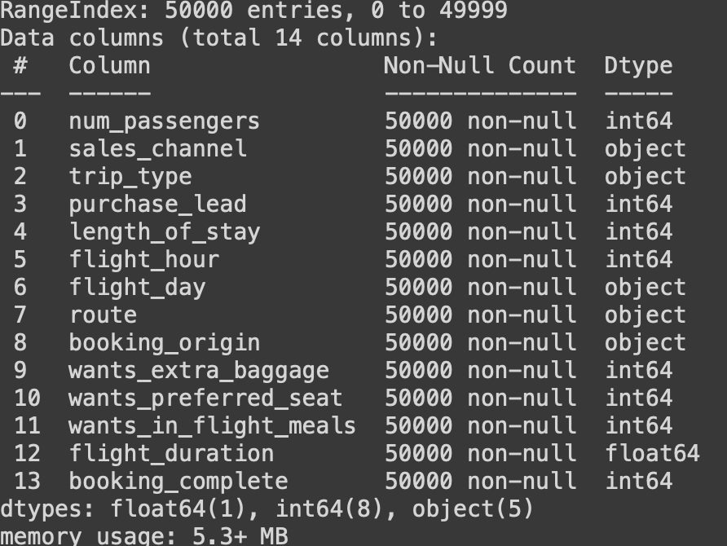
Data Dictionary
Classification Problem
Target Variable: booking_complete (Predict whether a booking is completed or not)

Slide 7
Categorical Features
sales_channel
trip_type
flight_day
route
booking_origin

Slide 8
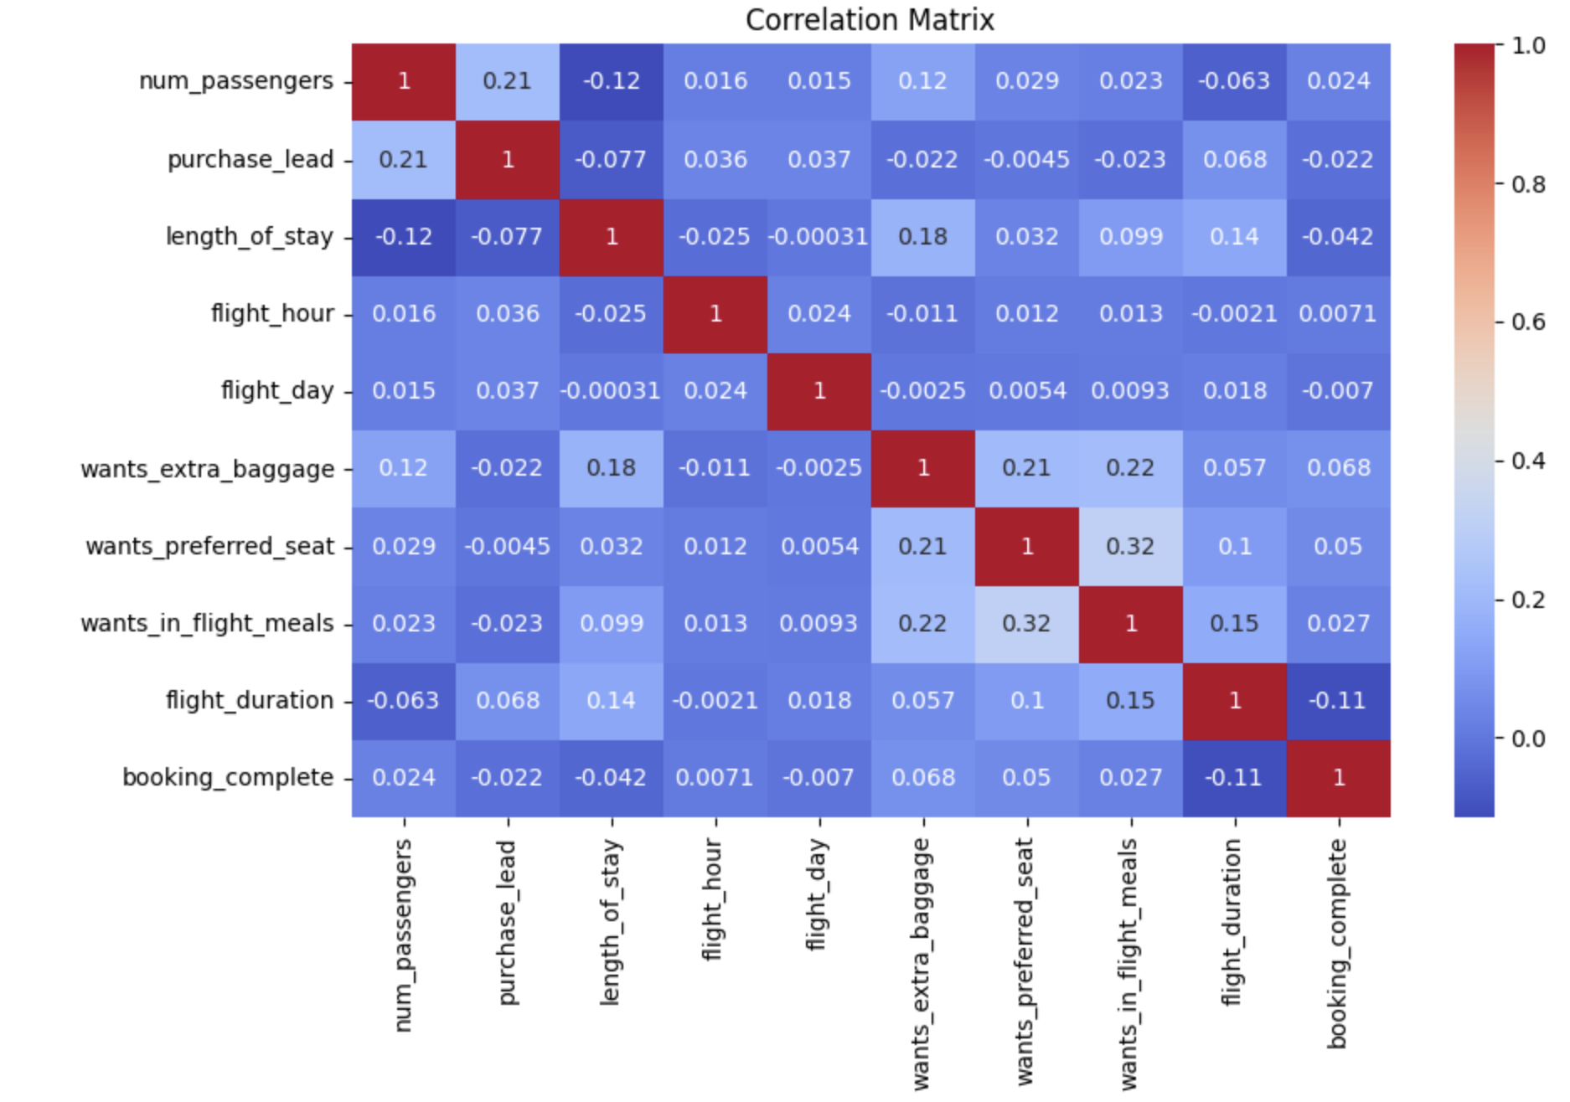
Correlation Matrix
Flight duration - negatively correlated with booking completion ( -0.11)
Number of passengers - negatively correlated with length of stay ( -0.12)

Slide 9
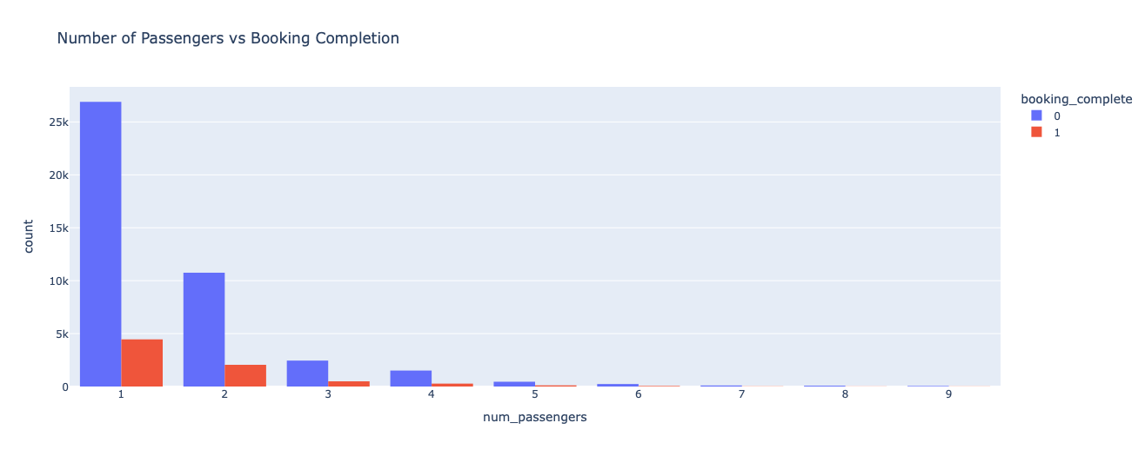
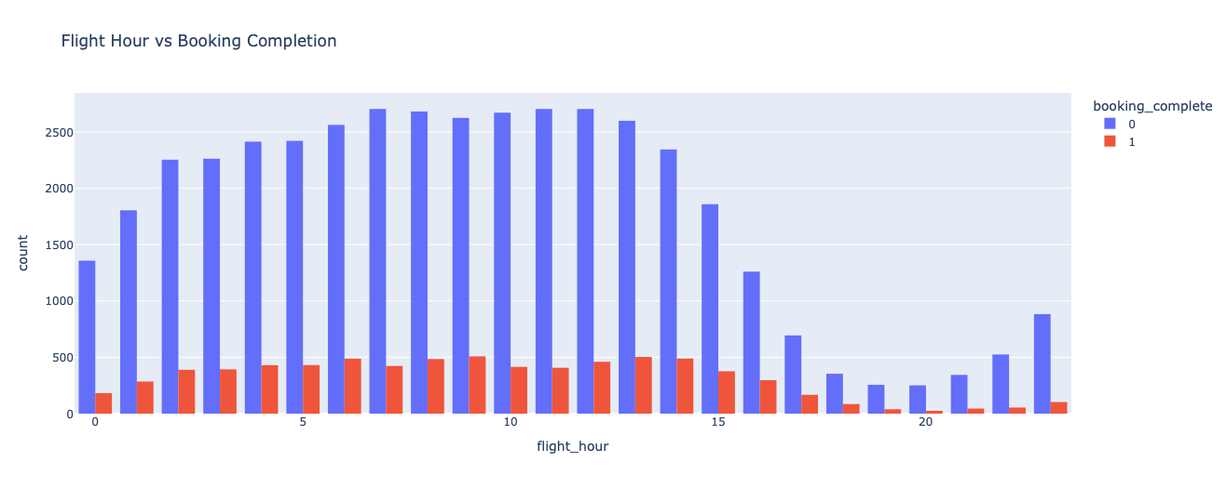
Visualizations

Slide 10
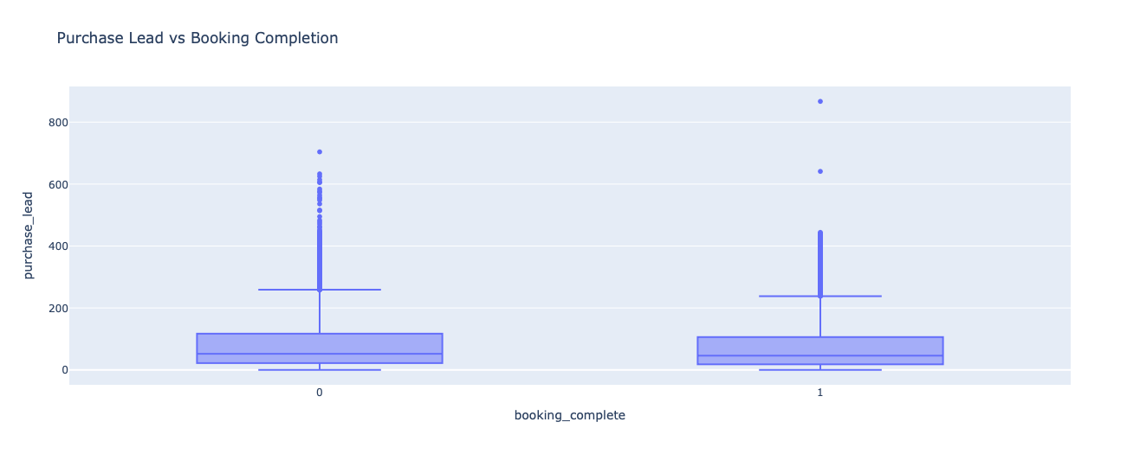
Visualizations (continued):

Slide 11
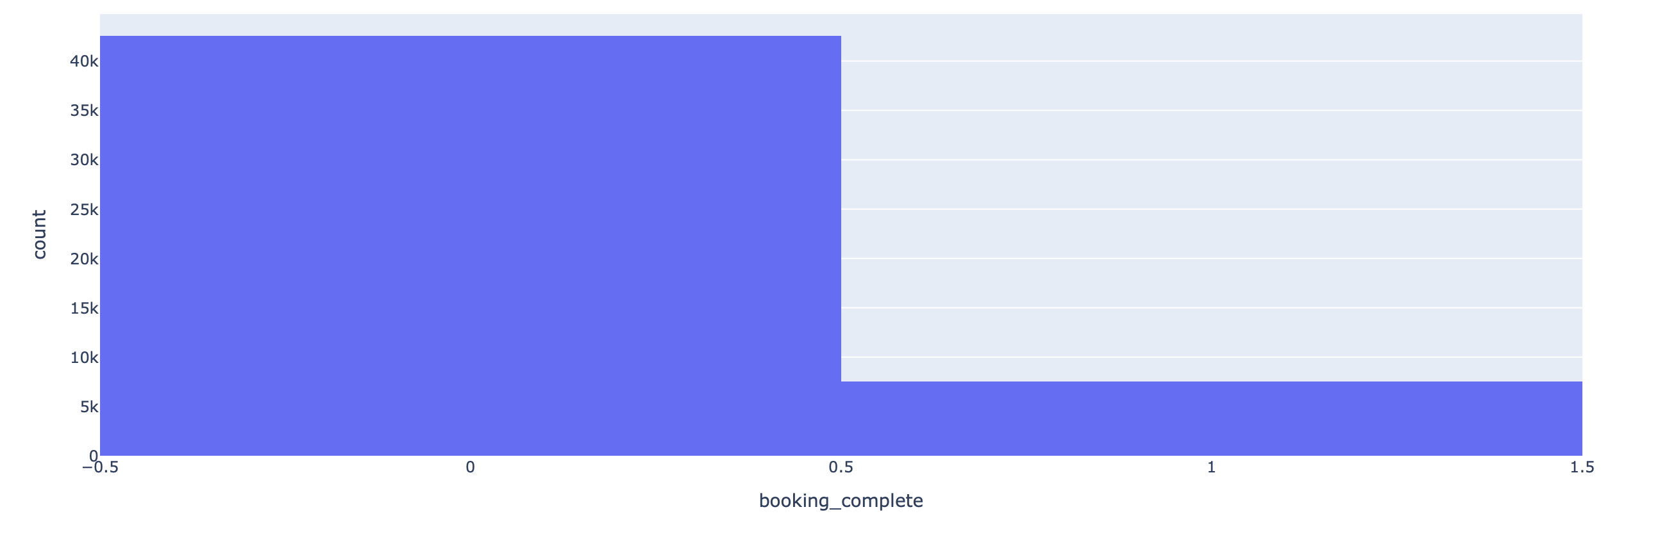

Understanding the Data
Highly imbalanced dataset – 85% (Booking not complete) | 15% (Booking complete)
To Address: SMOTE technique

Slide 12
Data Preprocessing
Categorical → Numeric
Flight Day : {1 to 7}
Label Encoding – (route, booking_origin)
One-Hot Encoding - (sales_channel, trip_type)
Mean and Mode Imputation
Apply SMOTE

Slide 13
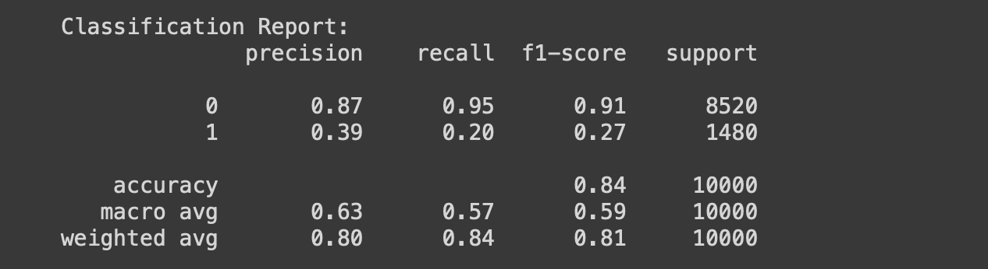
Model Training
Logistic Regression

Slide 14
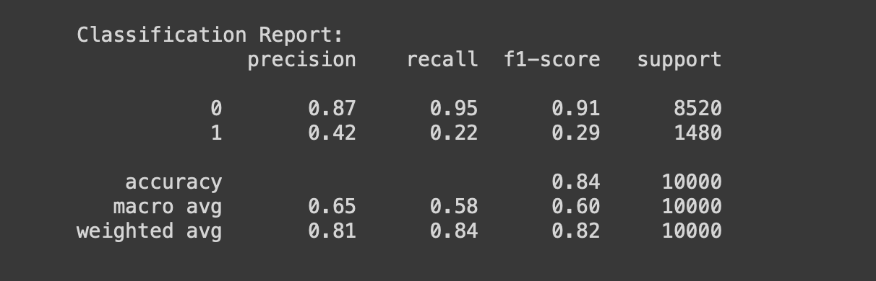
Random Forest

Slide 15
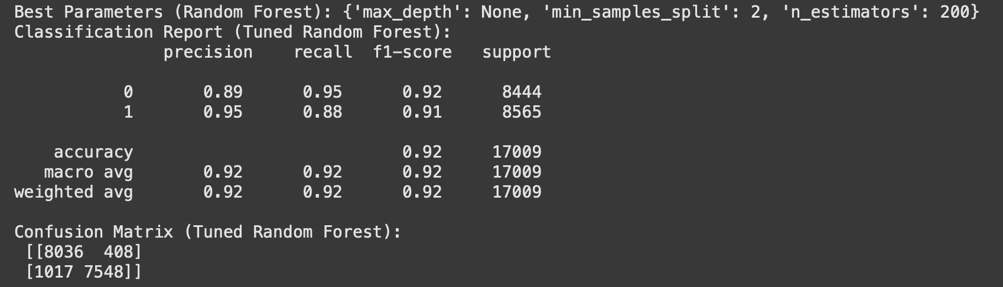
Hyperparameter Tuning:

Slide 16
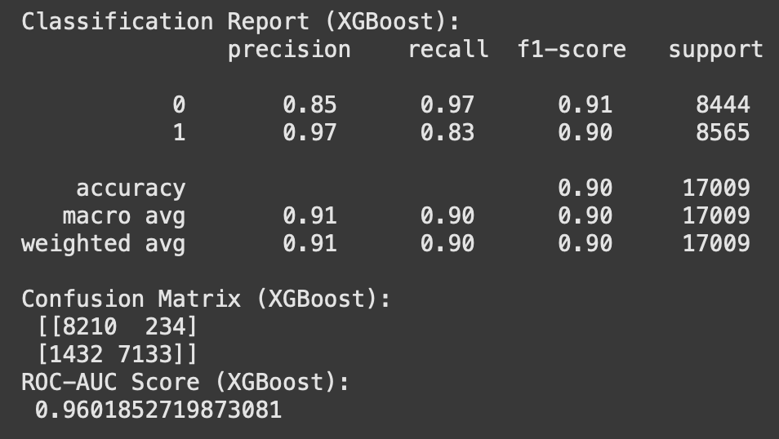
XGBoost Algorithm

Slide 17
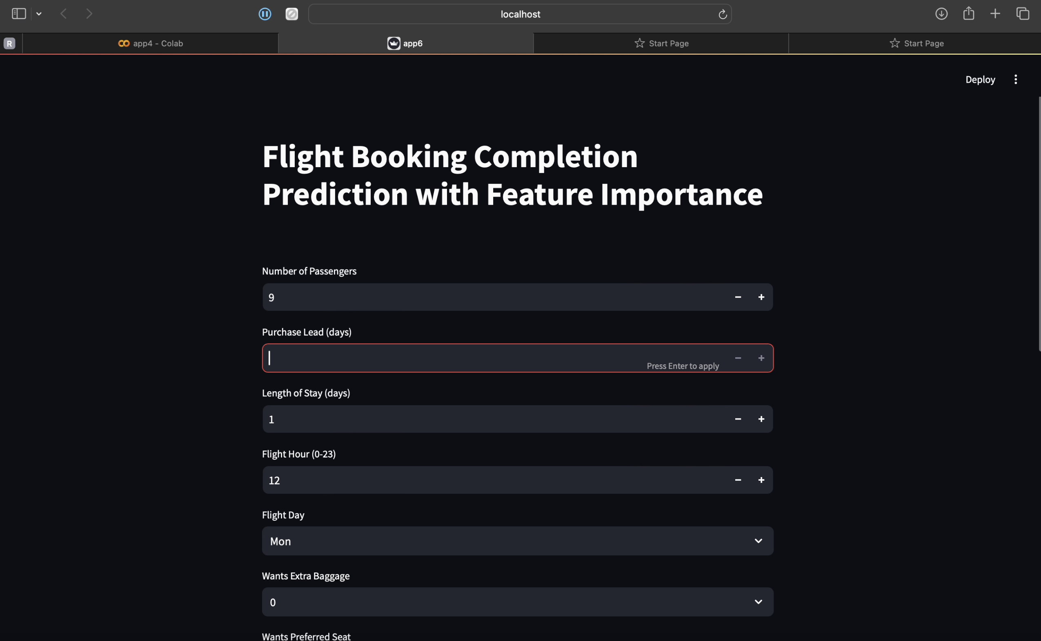
Streamlit Deployment

Slide 18
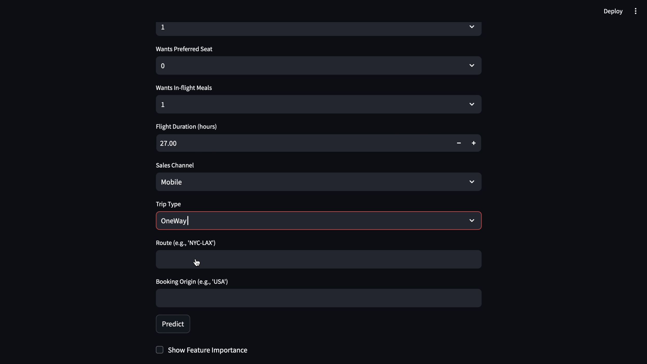

Slide 19
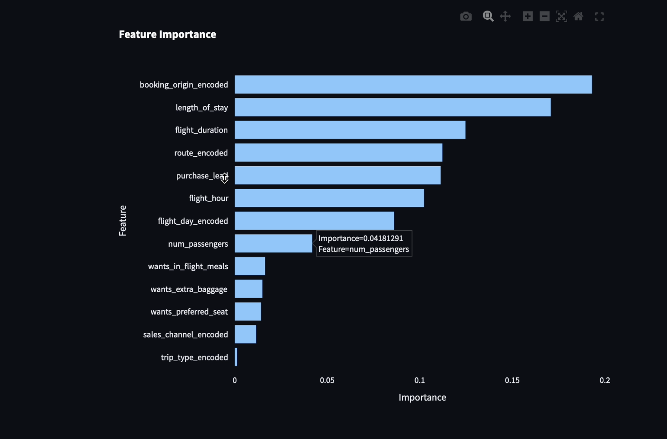
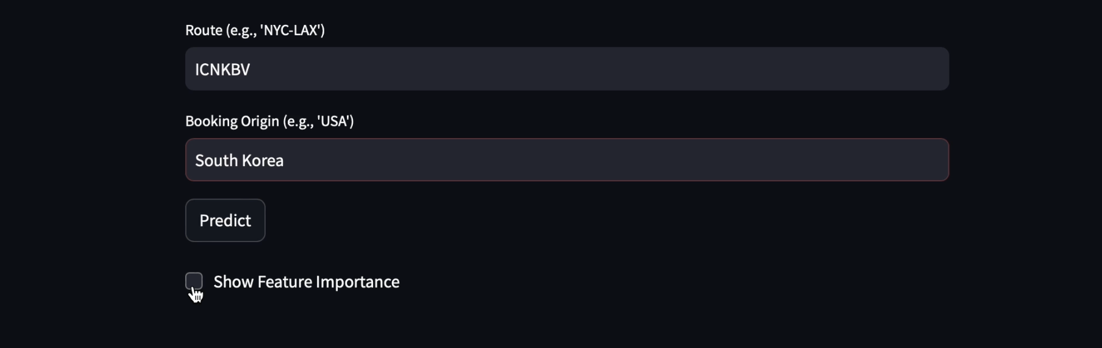

Slide 20

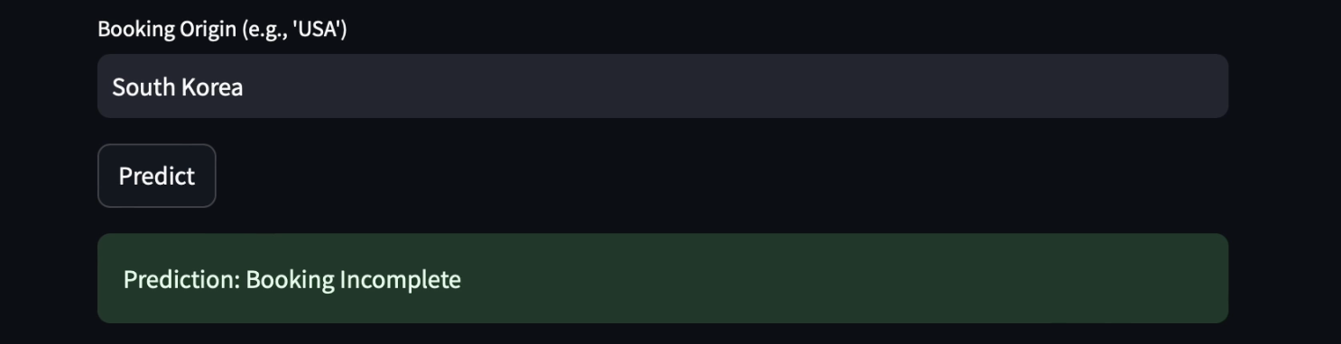
Prediction!

Slide 21

Conclusion
Better prediction → Better strategies
Feature importance
Better conversion rates
Better business outcomes

Slide 22

Thank You

